Slide 1
NOISE POLLUTION MONITORING

Slide 2
Objectives and significance
This project focuses on deploying IoT sensors to measure noise pollution in public areas.
The primary objective is to provide real-time noise level data accessible to the public through a platform or mobile app.
Significance: In recent years, noise pollution has been on the rise, significantly impacting public health and well being.
Noise pollution is linked to increased stress levels, sleep disturbances, and adverse effects on cardiovascular health.
The importance of addressing noise pollution is evident in its negative impact on our daily lives and quality of life

Slide 3
IoT Sensor System Design
1. Components of the IoT Sensor System:
Noise Sensors: These specialized sensors are strategically deployed in public areas to continuously monitor ambient noise levels.
Data Processing Unit: This unit receives data from the sensors, processes it, and prepares it for analysis.
Communication Module: It enables real-time data transmission from sensors to the central processing unit.
Power Supply: The system may use a combination of battery and solar power to ensure uninterrupted operation.
2. Sensor Placement Strategy:
Sensors are strategically placed in areas prone to noise pollution, such as busy streets, construction sites, or near transportation hubs.
3. Data Flow:
Noise data is continuously collected by the sensors.
The data is sent to the central processing unit via the communication module.
The central unit processes and analyses the data.
.4. Real-time Monitoring:
Users can access real-time noise levels through a platform or mobile app.
The IoT sensor system's design ensures accurate and continuous monitoring of noise pollution, facilitating data-driven decision-making and raising awareness about noise levels in public areas.

Slide 4
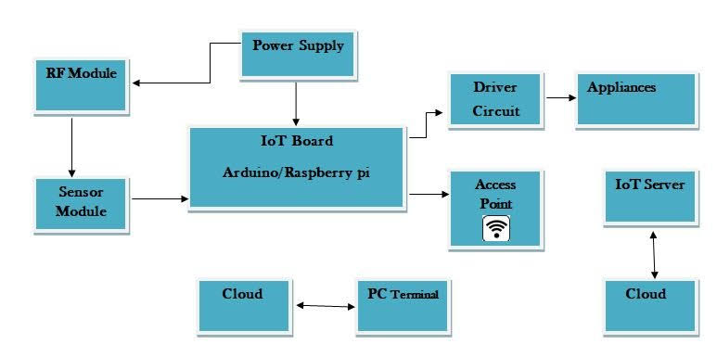
Fig.1: Flow of data from sensors to user devices

Slide 5
Real time Noise Data Collection by IoT Sensors
1.Sensors in Action:
IoT sensors continuously capture sound waves from their surroundings.
These sensors employ sensitive microphones to convert sound into electrical signals
2.Real-time Data Sampling:
The sensors perform real-time data sampling, recording. noise levels at specific intervals (e.g., every second).
These data points are then transmitted to a central processing unit.
3.Strategic Sensor Deployment:
Sensors are strategically deployed in various locations, including:
Busy urban streets
Residential neighbourhoods
Commercial areas
Near transportation hubs
Construction sites
4.Continuous Monitoring:
The sensors operate 24/7, ensuring uninterrupted data collection.
Data is transmitted in real-time to the central processing unit, allowing for immediate analysis and public access

Slide 6
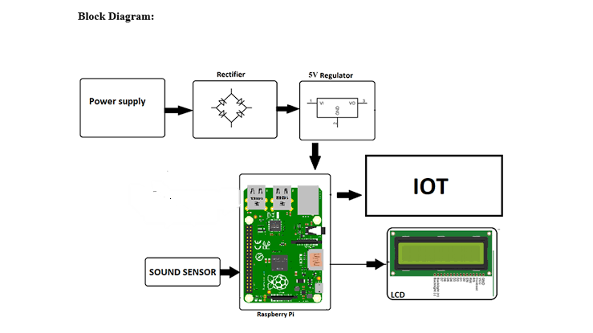
Fig.2: Block diagram of noise pollution monitoring

Slide 7
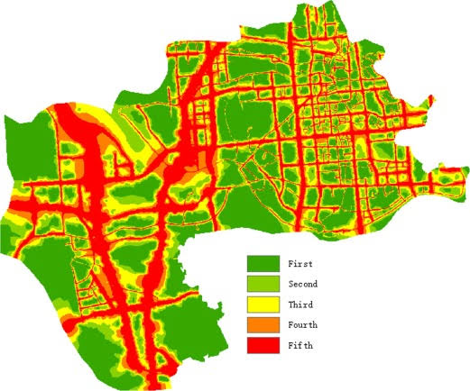
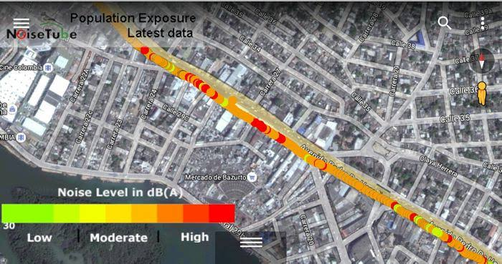
Fig.3: Map highlighting noise pollution deployment locations

Slide 8
Processing collected noise data
1.Data Reception:
Once IoT sensors collect noise data, it is transmitted to a central processing unit
Data is received in real time, ensuring up to date information.
2.Data Pre-processing:
Raw noise data often requires pre-processing to remove noise artifacts and inconsistencies.
Python scripts are employed to clean and format the data.
3.Data Analysis and Visualizations:
Python libraries, such as NumPy and Pandas, are used to perform in-depth analysis.
Visualisation tools like Matplotlib and Seaborn are employed to create graphs and charts.
4.Alert generation:
Python algorithms can be designed to trigger alerts when noise levels exceed predefined thresholds.
These alerts can be sent to relevant authorities or displayed on the public platform.

Slide 9
Advantages and impact
Informed decision making.
Improved public health.
Quality of life enhancement.
Community engagement
Environmental impact
Educational opportunities.
Data driven insights.
Safety improvements.

Slide 10
Overcoming project challenges
1.Sensor Calibration and Accuracy:
Challenge: Ensuring the accuracy and calibration of noise sensors.
Solution: Regular sensor maintenance, calibration checks, and firmware updates were implemented to maintain data accuracy.
2.Data Transmission and Connectivity:
Challenge: Maintaining consistent data transmission from remote sensor locations.
Solution: Improved communication infrastructure and redundancy systems were introduced to ensure uninterrupted data flow.
3. Data Security and Privacy:
Challenge: Protecting sensitive data collected from public areas.
Solution: Robust encryption and data anonymization techniques were employed to safeguard privacy and comply with data protection regulations
4.Power Supply Reliability:
Challenge: Ensuring uninterrupted power supply to IoT sensors, especially in remote locations.
Solution: Hybrid power sources, combining batteries and solar panels, were implemented to provide reliable power.

Slide 11
5. Community Engagement:
Challenge: Engaging communities and encouraging participation in noise reduction efforts.
Solution: Public awareness campaigns, educational initiatives, and involving local stakeholders helped foster community engagement.
6.Budget Constraints:
Challenge: Managing project costs within budget constraints.
Solution: Careful budget planning, seeking grants or funding opportunities, and cost-effective sensor selection were employed to manage expenses.
7. Data Analysis Complexity:
Challenge: Managing and analyzing the large volume of noise data collected.
Solution: Advanced data analysis tools and algorithms were developed to streamline data processing and generate meaningful insights.
8.Policy Implementation:
Challenge: Ensuring that noise reduction policies are effectively implemented.
Solution: Collaboration with policymakers, advocacy efforts, and transparency in sharing data-driven results helped drive policy changes.

